Slide 1

AWS SECURITY AND CONFIGURATION

Slide 2

Content Introduction
Security group in AWS.
Restrict access to TCP ports in AWS.
CIDR (Classless Inter-Domain Routing)
Class A
Class B
Class C

Slide 3

Security Group
Security Groups operate at the Instance level and control inbound and outbound traffic.
Security groups are stateful meaning that if you allow inbound traffic and automatically allow outbound traffic.
Inbound rules control incoming traffic and outbound rules controls outgoing traffic.
Changes to security group rules take effects immediately without requiring instance restarts.

Slide 4
Security Groups in AWS
Name | Default | Adjustable
VPC security groups per Region | 2500 | Yes
Inbound or outbound rules per security group | 60 | Yes
Security groups per network interface | 5 | Yes (Up to 16)

Slide 5
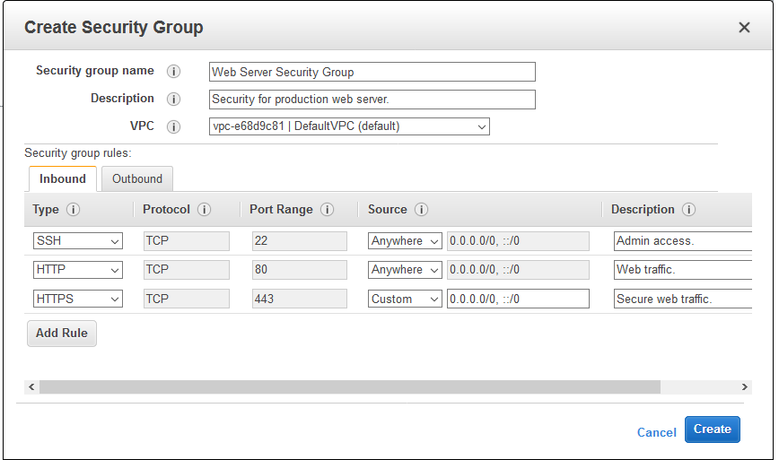
Security Group Rules

Slide 6
Difference between Security group and Network ACLs.
Security Group | Network ACLs
Operate at the Instance level | Operate at the Subnet level
Applies to an instance only if it is associated with the instance | Applies to all the instances deployed in the subnet
Support allow rules only | Support allow rules and deny rules
Stateful: return traffic is allowed, regardless of the rules | Stateless: Return traffic must be explicitly allowed by rules
 | NACls are associated with subnet and apply their rules to all resources within that subnet

Slide 7
Restrict access to TCP ports on ec2 instances in AWS.
Select the instance for which you want to restrict access to TCP ports.
Security Groups:
Security groups act as a virtual firewall for your EC2 instances. You can define inbound and outbound rules to control traffic. To restrict access to TCP ports,
Go to the AWS Management Console.
Open the EC2 dashboard.
Select the EC2 instance for which you want to restrict access.
In the "Description" tab, scroll down to the "Security groups" section.
Click on the associated security group.
In the "Inbound rules" tab, edit the inbound rules to allow only specific IP addresses or CIDR ranges on the
desired TCP ports. Remove any rules that grant unrestricted access.
Save the changes.
By configuring security group rules, you can allow access only from specified IP addresses, ensuring that other IPs are denied access.

Slide 8

Network Access Control Lists (NACLs):
NACLs are stateless network filters that control traffic at the subnet level. While security groups are associated with instances, NACLs are associated with subnets. You can use NACLs to restrict access to TCP ports by setting rules similar to those in security groups.
Go to the AWS Management Console.
Open the VPC dashboard.
Select the appropriate VPC.
In the "Network ACLs" section, edit the rules for the inbound and outbound traffic to restrict access to specific IP addresses and TCP ports.

Slide 9
CIDR
CIDR stands for "Classless Inter Domain Routing" and it is a method for allocating and specifying IP Addresses and their routing on the Internet. CIDR allows for more flexible allocation of IP addresses then traditional methods.
CIDR notation consists of an IP address followed by a slash ("/") and a number.
CIDR is nothing but part of large IP address can be divided into smaller parts.

Slide 10

Deference Between
Private IP
Private IP address is an IP address reserved for use within an internal private network and is not routable on the public internet.
Used with LAN (Local Area Network)
Free of charge
Public IP
Public IP Address is an IP address that's reachable from the Internet.
You can use public addresses for communication between your instances and the internet.
Used on Public Network
Cost associated with using Public IP

Slide 11
Ranges Of CIDR
Total CIDR IP's- 65536
Reserved IP's- 4
Classes | Private IP | Public IP
Class A | 10.0.0.0 to 10.255.255.255 | 1.0.0.0 to 9.255.255.255 11.0.0.0-126.255.255.255
Class B | 172.16.0.0 to 172.31.255.255 | 128.0.0.0 to 172.15.255.255 172.32.0.0 - 191.255.255.255
Class C | 192.168.0.0 to 192.168.255.255 | 192.0.0.0 - 192.167.255.255 192.169.0.0 to 223.255.255.255

Slide 12
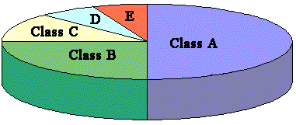
Range and Classes of CIDR

Slide 13
IPv4 & IPv6
IPv4
IPv4 stands for Internet Protocol version 4. It is the underlying technology that makes it possible for us to connect our devices to the web.
IPv6
IPv4 is not sufficient for network devices due to that we need to use IPv6.

Slide 14
CIDR Number of mask /8, /16, /24, /32
A subnet mask is a 32-bit number that divides an IP address into network and host portions. It is used in networking to define the boundaries between the network and host parts of an IP address, enabling efficient routing and addressing within a network. Subnetting is a technique that involves breaking down a larger network into smaller, more manageable sub-networks or subnets.

Slide 15

Subnet mask Calculation
Using the formula 2H, where H represents the host bit.
Class A = 2*24 = 16,777,216 total IPs
Class B = 2*16 = 65,536 total IPs
Class C = 2*8 = 256 total IPs

Slide 16
Thank You..
Vaibhav Kalel

